Slide 1
Lesson Planning

Slide 2
Session Plan
Warm up questions………………………………………………………….…………..…..5 minutes
What is a lesson plan?..........................................................................10 minutes
Why to plan a lesson?..........................................................................10 minutes
Different parts of a lesson plan…………………………………………….…………20 minutes
A sample lesson plan……………………………………………………………….……….5 minutes
Q & A……………………………………………………………………………………….……….5 minutes

Slide 3
Warm up questions
1

Slide 4
Questions
How often do you plan? (1 sometimes, 2 often, 3 always)
How much time do you allocate for that?
Do you share the plan with your students?

Slide 5
What is a lesson plan?
2

Slide 6
Lesson Plan
Lesson planning is the activity which the teacher performs before the actual lesson takes place. A lesson plan is a detailed 1……………of the instructional 2………….. and 3…………. activities to be performed during the teaching/learning process.
1. description, 2. strategies, 3.learning

Slide 7
Lesson Plan Steps
3

Slide 8
Steps
A. Determining appropriate instruction aids and methods.
B. Management of the learning resources, environment and activities.
C. Determining evaluation process.
D. Identification of learning/teaching objectives, activities and tasks.
E. Sequencing of these activities and tasks.

Slide 9
Steps
1. Identification of learning/teaching objectives, activities and tasks.
2. Sequencing of these activities and tasks.
3. Determining appropriate instruction aids and methods.
4. Management of the learning resources, environment and activities.
5. Determining evaluation process.

Slide 10
Why to plan a lesson?
3

Slide 11
A Lesson Plan:
Reduces uncertainty or panic
Gives confidence and clarity

Slide 12
A Lesson Plan:
Provides
a map to follow
Provides a record/working document

Slide 13
A Lesson Plan:
Gives your teaching a framework
Reminds when distracted

Slide 14
Organizes the time and activities flow
A Lesson Plan:
Helps the sub teacher

Slide 15
A Lesson Plan Ensures Consistency Across School
A lesson plan can maximize the consistency among teachers at a school; however, their individual differences need to be appreciated!

Slide 16
Different parts of a lesson plan
4

Slide 17
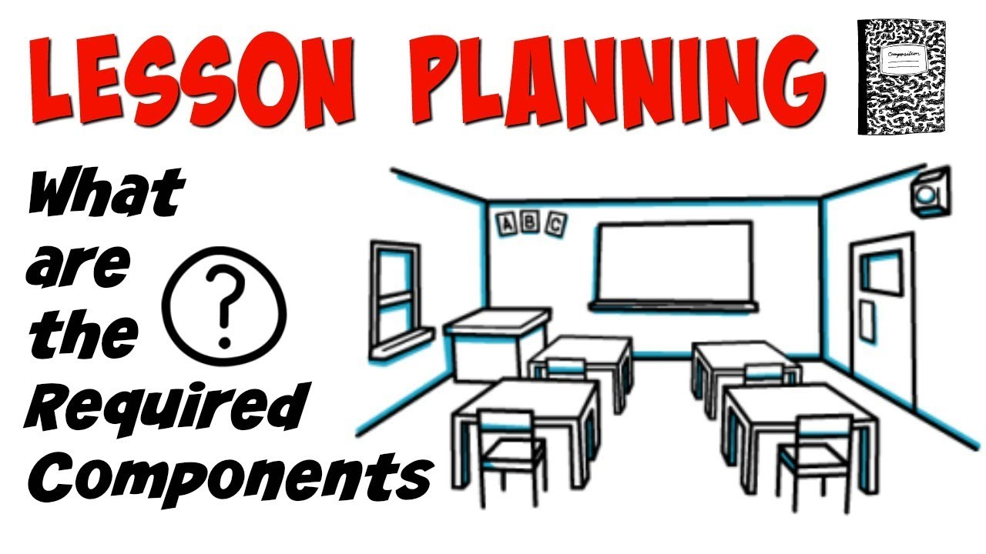
Components of a lesson plan
Class profile: Differentiation
Stage
Time
Aims/Objective(s)
Procedures
Interactions
Aids/Materials
Feedback slot
Seating arrangements?
Anticipated problems & solutions

Slide 18
Match
Class profile: Differentiation
Stage
Time
Aims/Objective(s)
Procedures
Interactions
Aids/Materials
Feedback slot
Seating arrangements?
Anticipated problems & solutions
Trainer to teachers/teachers to teachers
Warm up questions
They might find the lesson boring
To engage the participants
Toros University teachers, 25-65,………
Five minutes
Q & A time at the end
Groups of 4 teachers
Three questions on the smartboard
Smart board, slides, pen and paper,…..

Slide 19
Matched
Class profile: Differentiation
Stage
Time
Aims/Objective(s)
Procedures
Interactions
Aids/Materials
Feedback slot
Seating arrangements?
Anticipated problems & solutions
Toros University teachers, 25-65,………
Warm up questions
Five minutes
To engage the participants
Three questions on the smartboard
Trainer to teachers/teachers to teachers
Smart board, slides, pen and paper,…..
Q & A time at the end
Groups of 4 teachers
They might find the lesson boring

Slide 20
A sample lesson plan
5

Slide 22
Lesson Plan Components
Class profile
Stage
Time
Aims/Objective(s)
Procedures
Interactions
Aids/Materials
Feedback slot
Seating arrangements
Anticipated problems & solutions

Slide 24
Class profile
Age
Motivational level
Attendance record
Participation record
Engagement level
Learning style
Strengths and weaknesses

Slide 25
A good session is a good story with a beginning, a climax and an end!
Teach the new lesson (25 mins)
Socialize and review (7 mins)
Review and wrap up (7 mins)

Slide 26
Sequential vs. Consequential Staging
?????:
Sequence of activities not always related
Activities may have different themes.
A lot of cognitive load
?????:
Cohesion and coherence; one activity leads to another. The more seamless the transition is, the better!
Integration and consistency, holistic.

Slide 27
Sequential vs. Consequential Staging
Sequential:
Sequence of activities not always related
Activities may have different themes.
A lot of cognitive load
Consequential:
Cohesion and coherence; one activity leads to another. The more seamless the transition is, the better!
Integration and consistency, holistic.

Slide 28
Seating Arrangements

Slide 29
A sample simple session plan
Task | Objective | Estimated Time
Revision | Revieing previous lesson | 5 minutes
Reading | Learning vocabulary and ideas | 15 minutes
Discussion | Discussing the reading class wide | 10 minutes
Landing | Reviewing and assigning homework | 5 minutes

Slide 30
Final words!
Teaching is not about your English knowledge only! Discipline speaks louder!
Prepare a lesson plan to show your respect to the class
Be realistic in your planning
Involve the students in planning!
Plan for learning and not for formalities!

Slide 31
Q & A
6

Slide 32
Thanks for listening!
amir@kardes.com.tr

